Slide 1


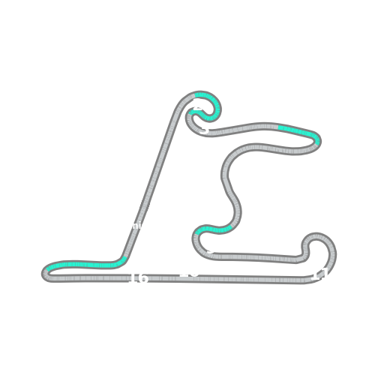


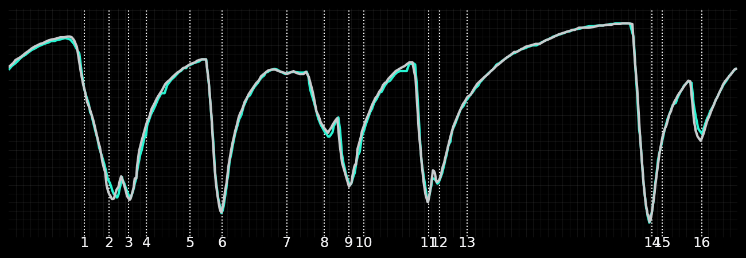
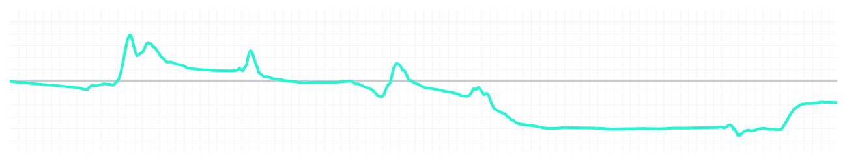
Chinese GP Sprint Quali Q2
Kimi Antonelli
Driver
George Russell
Driver
Lap Time
01:31.475
01:31.346
Lap Time
Sector 1
24.488
Speed Trap 1
282 kp/h
Speed Trap 1
282 kp/h
Sector 1
24.485
Sector 2
27.522
Speed Trap 2
277 kp/h
Gap
0.129
Gap
-0.129
Speed Trap 2
278 kp/h
Sector 2
27.403
Sector 3
39.465
Speed Final Line
270 kp/h
Corner Advantage
10/17
Corner Advantage
7/17
Speed Final Line
271 kp/h
Sector 3
39.458
FULL THROTTLE
56%
60%
FULL THROTTLE
HEAVY BREAKING
18%
17%
HEAVY BREAKING
%LAP TIME
CORNERING
26%
23%
CORNERING
%LAP TIME
SPEED
SPEED
DELTA TIME
DELTA TIME

Slide 2

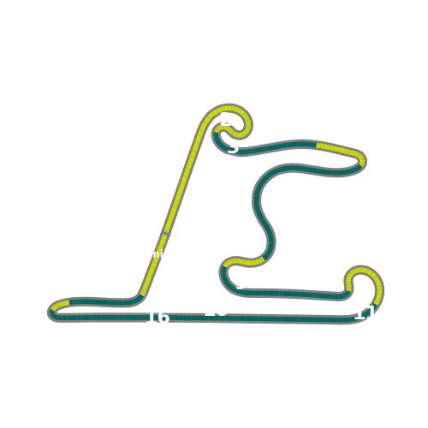


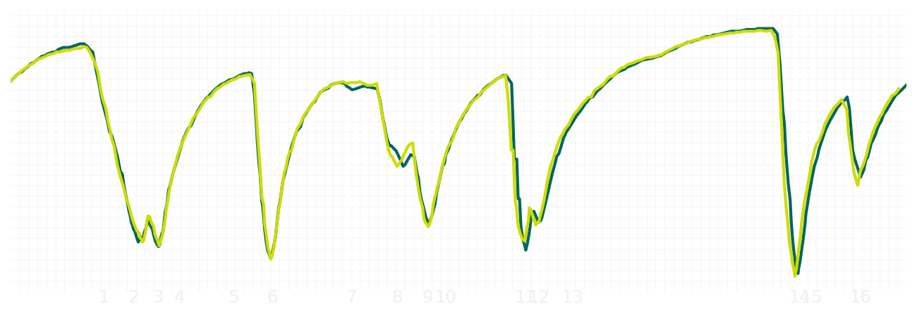
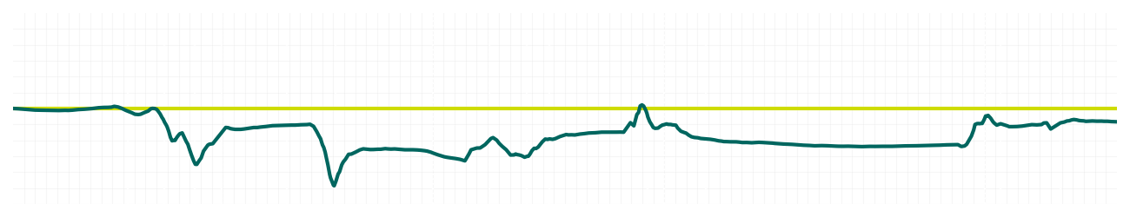
Chinese GP Sprint Quali Q2
Fernando Alonso
Driver
Lance Stroll
Driver
Lap Time
01:31.815
01:31.742
Lap Time
Sector 1
24.392
Speed Trap 1
280 kp/h
Speed Trap 1
280 kp/h
Sector 1
24.390
Sector 2
27.612
Speed Trap 2
277 kp/h
Gap
0.073
Gap
-0.073
Speed Trap 2
275 kp/h
Sector 2
27.499
Sector 3
39.811
Speed Final Line
266 kp/h
Corner Advantage
8/17
Corner Advantage
9/17
Speed Final Line
267 kp/h
Sector 3
39.853
FULL THROTTLE
58%
60%
FULL THROTTLE
HEAVY BREAKING
21%
17%
HEAVY BREAKING
%LAP TIME
CORNERING
21%
23%
CORNERING
%LAP TIME
SPEED
SPEED
DELTA TIME
DELTA TIME

Slide 3

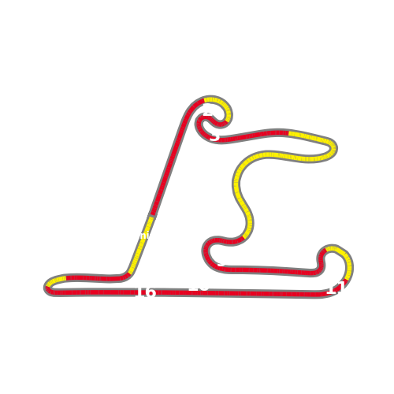


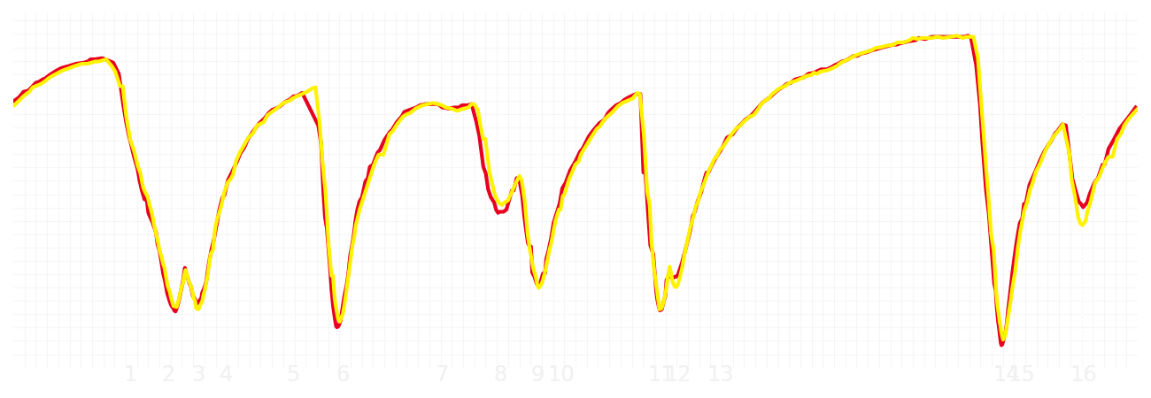
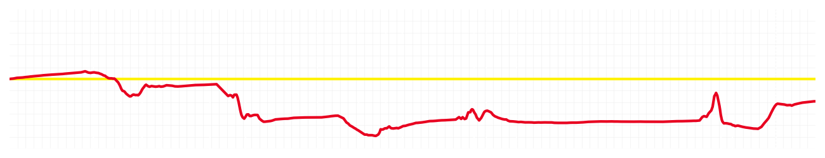
Chinese GP Sprint Quali Q2
Charles Leclerc
Driver
Lewis Hamilton
Driver
Lap Time
01:31.561
01:31.384
Lap Time
Sector 1
24.417
Speed Trap 1
284 kp/h
Speed Trap 1
283 kp/h
Sector 1
24.355
Sector 2
27.589
Speed Trap 2
278 kp/h
Gap
0.177
Gap
-0.177
Speed Trap 2
277 kp/h
Sector 2
27.383
Sector 3
39.555
Speed Final Line
269 kp/h
Corner Advantage
6/17
Corner Advantage
11/17
Speed Final Line
267 kp/h
Sector 3
39.646
FULL THROTTLE
56%
59%
FULL THROTTLE
HEAVY BREAKING
20%
23%
HEAVY BREAKING
%LAP TIME
CORNERING
24%
18%
CORNERING
%LAP TIME
SPEED
SPEED
DELTA TIME
DELTA TIME

Slide 4

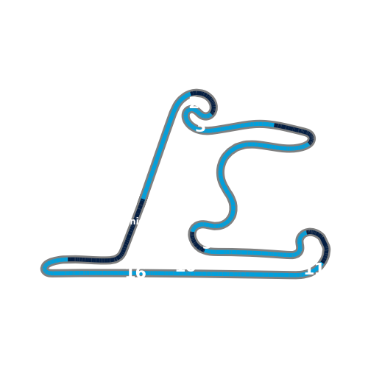


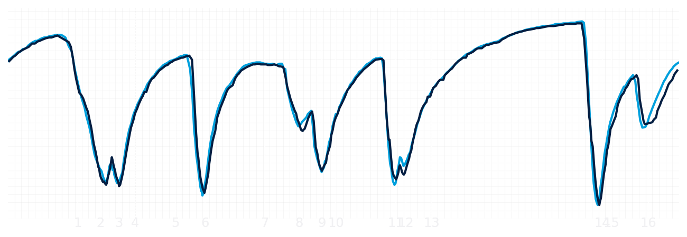
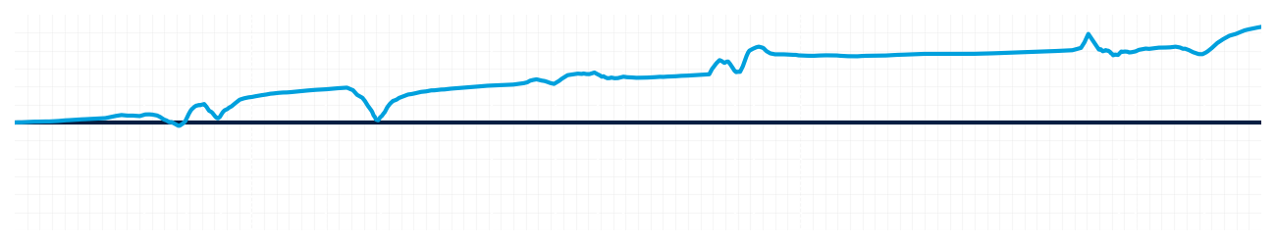
Chinese GP Sprint Quali Q2
Alexander Albon
Driver
Carlos Sainz
Driver
Lap Time
01:31.539
01:32.325
Lap Time
Sector 1
24.321
Speed Trap 1
281 kp/h
Speed Trap 1
281 kp/h
Sector 1
24.615
Sector 2
27.612
Speed Trap 2
277 kp/h
Gap
-0.786
Gap
0.786
Speed Trap 2
276 kp/h
Sector 2
27.668
Sector 3
39.606
Speed Final Line
271 kp/h
Corner Advantage
5/17
Corner Advantage
12/17
Speed Final Line
262 kp/h
Sector 3
40.042
FULL THROTTLE
56%
58%
FULL THROTTLE
HEAVY BREAKING
21%
21%
HEAVY BREAKING
%LAP TIME
CORNERING
23%
21%
CORNERING
%LAP TIME
SPEED
SPEED
DELTA TIME
DELTA TIME

Slide 5

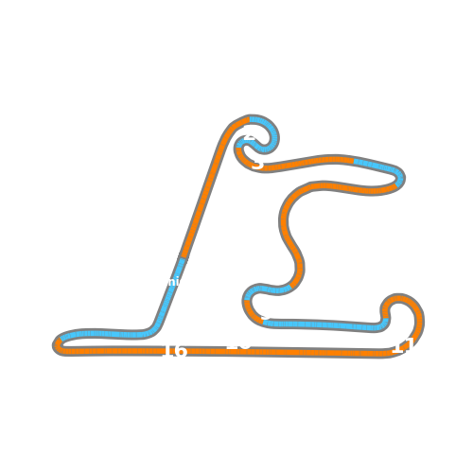


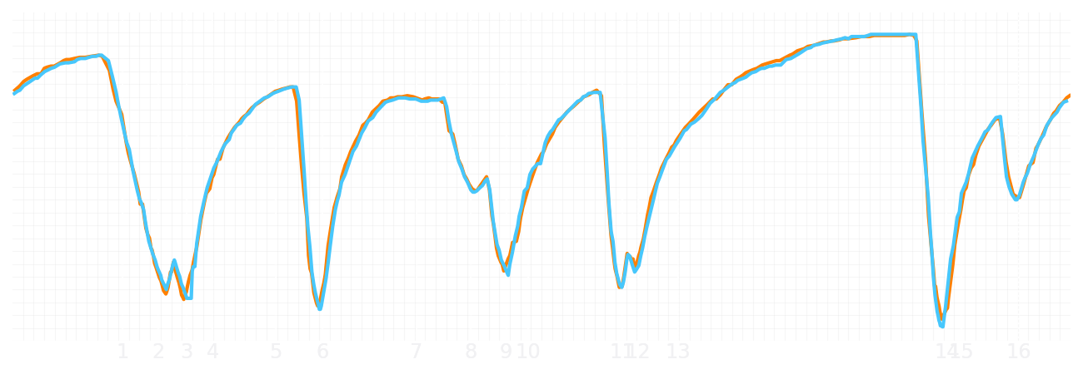
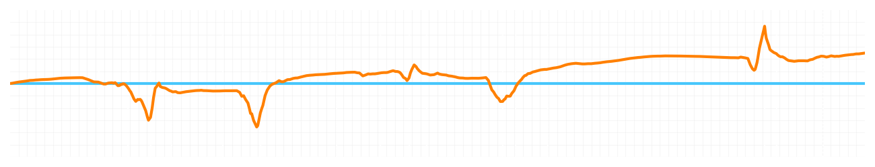
Chinese GP Sprint Quali Q2
Lando Norris
Driver
Oscar Piastri
Driver
Lap Time
01:31.174
01:31.362
Lap Time
Sector 1
24.278
Speed Trap 1
279 kp/h
Speed Trap 1
280 kp/h
Sector 1
24.323
Sector 2
27.499
Speed Trap 2
275 kp/h
Gap
-0.188
Gap
0.188
Speed Trap 2
276 kp/h
Sector 2
27.566
Sector 3
39.397
Speed Final Line
271 kp/h
Corner Advantage
7/17
Corner Advantage
10/17
Speed Final Line
269 kp/h
Sector 3
39.473
FULL THROTTLE
58%
56%
FULL THROTTLE
HEAVY BREAKING
19%
19%
HEAVY BREAKING
%LAP TIME
CORNERING
23%
25%
CORNERING
%LAP TIME
SPEED
SPEED
DELTA TIME
DELTA TIME

